Slide 1

RUNGTA COLLEGE OF DENTAL SCIENCES & RESEARCH
TITLE OF THE TOPIC-
CLEFT LIP AND PALATE
DEPARTMENT OF ORTHODONTICS AND DENTOFACIAL ORTHOPAEDICS

Slide 2
Specific learning Objectives
CORE AREAS | DOMAIN | CATEGORY
INTRODUCTION | AFFECTIVE | DESIRE TO KNOW
INCIDENCE | AFFECTIVE | DESIRE TO KNOW
EMBRYOLOGY | COGNITIVE | NICE TO KNOW
ETIOLOGY | COGNITIVE | MUST KNOW
CLASSIFICATION | PSYCHOMOTOR | MUST KNOW
PROBLEM | COGNITIVE | MUST KNOW
MANAGEMENT | PSYCHOMOTOR | NICE TO KNOW

Slide 3
CONTENTS
PART I
Introduction
Incidence
Embryology
Etiology & Predisposing factors
Classifications
PART II
Classifications
Problems associated with clefts
Management
Summary

Slide 4
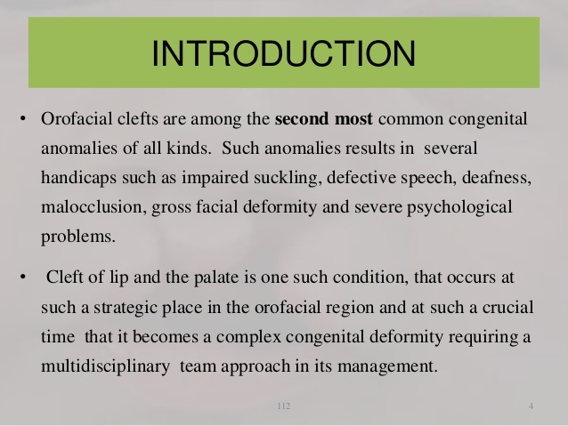

Slide 5
INCIDENCE
The reported incidence varies accordingly:-
Geographic location
Ethnicity
Gender
Socioeconomic status

Slide 6
The incidence is 1 in every 600-1000 births
Least incidence- Negroids
Highest incidence- Mongoloids
Cleft lip common among Males
Cleft palate common among Females

Slide 7
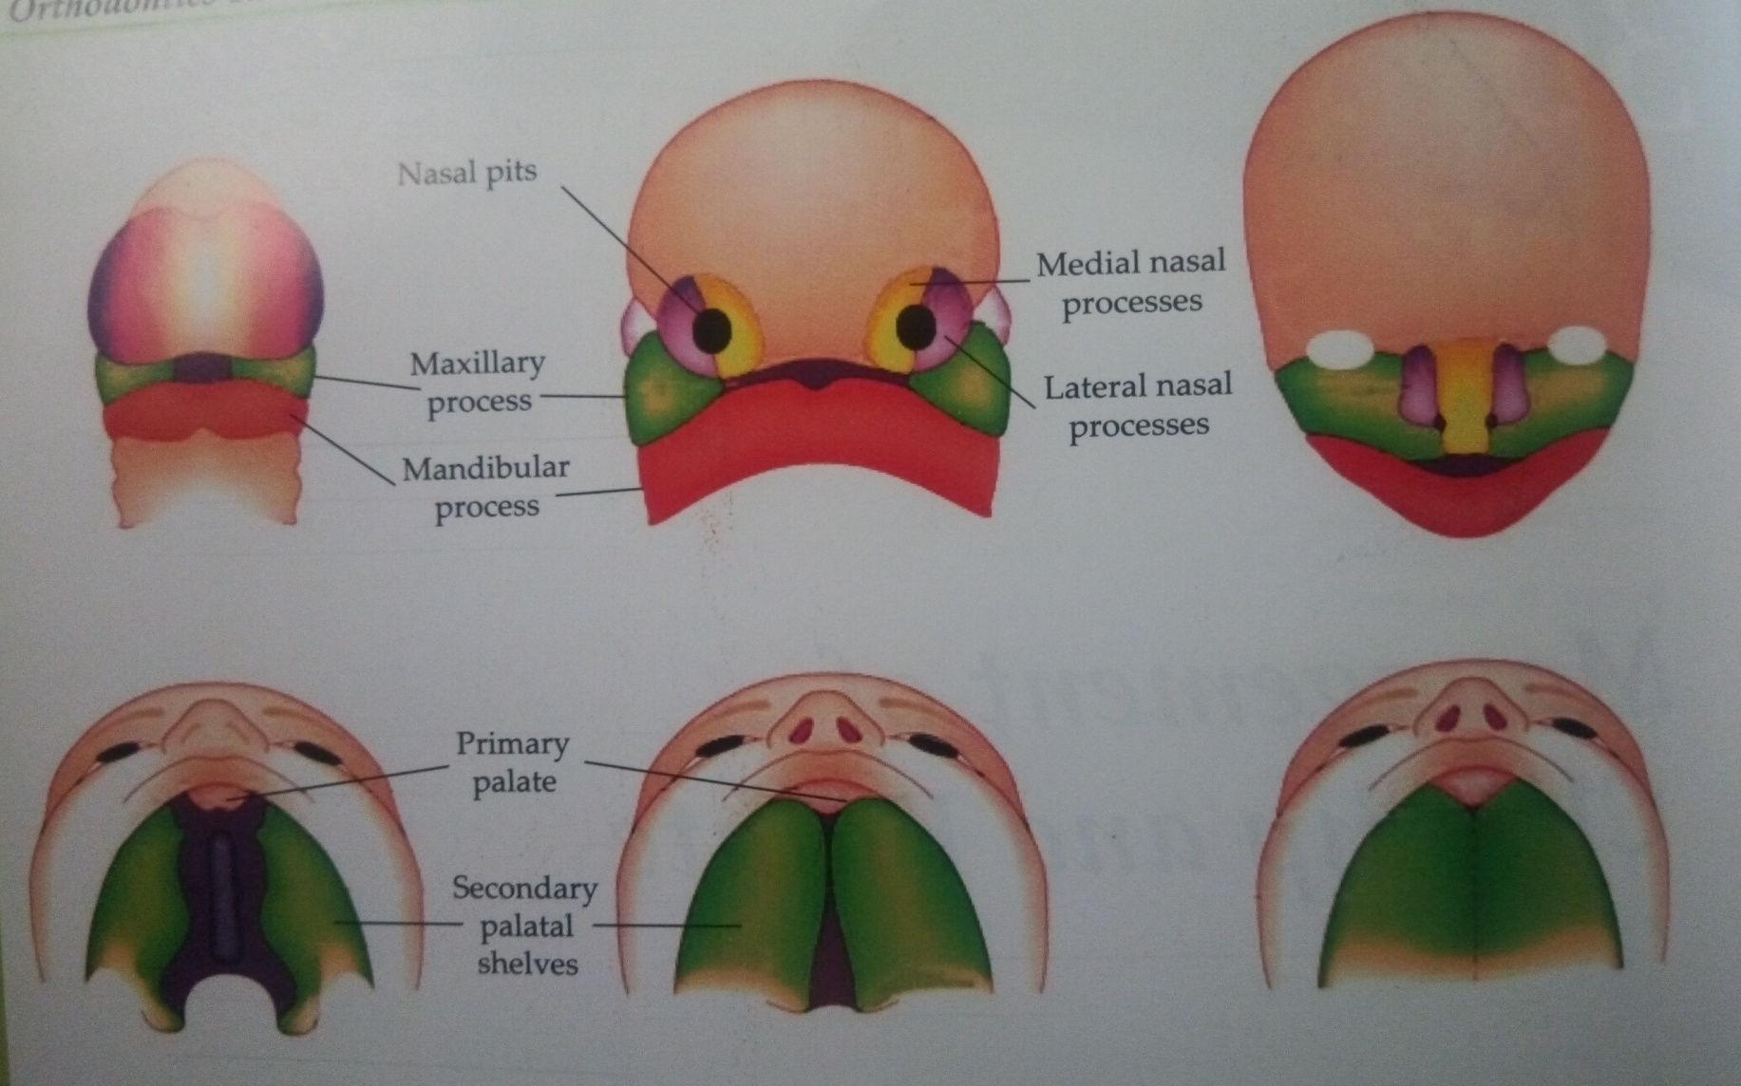
EMBRYOLOGICAL BACKGROUND

Slide 8
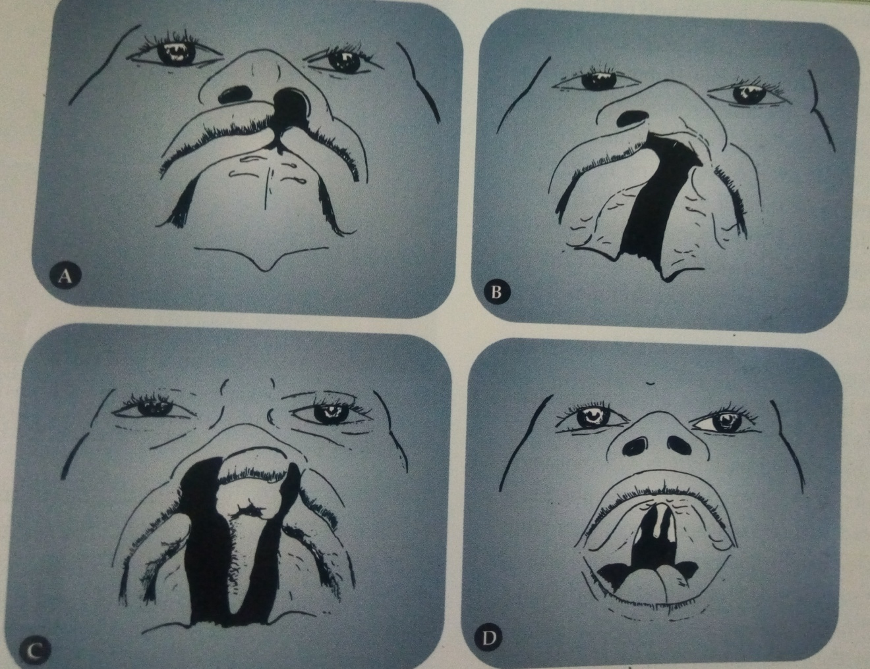
A.Unilateral cleft involving lip and alveolus. B.unilateral cleft involving lip and palate, C.bilateral cleft involving lip and palate
D. median cleft involving palate only

Slide 9
ETIOLOGY OF CLEFT LIP AND PALTE
ETIOLOGY
HEREDITY
ENVIRONMENT
MULTIFACTORIAL ETIOLOGY

Slide 10
A.HEREDITY
Cleft can be transmitted as a dominant or a recessive trait.
Transforming growth factor alpha (TGFA) transforming growth factor beta 3 (TGFB3) AP2 and MSX1 are genes that plays major roles in the development of cleft lip cleft palate.

Slide 11
IDENTIFICATION OF SOME POTENTIAL GENES CAN BE DONE IN FOLLOWING WAYS:-
LINKAGE
ASSOCIATION
ANIMAL MODELS

Slide 12
1.Linkage
Linkage is a technique that allowa research to look for chromosome segments. Chromosome segment from affected family members are compared with the unaffected family member to look for share chromosome segment only in those with clefts.
LIMITATION:-
Limited no. of family member and even fewer affected population.

Slide 13
2.ASSOCIATION
Association helps in understandind the developmental biology that is applied to identify which genes are expressed at different time in facial development, there by providing possible candidate genes.

Slide 14
3.ANIMAL MODELS
Animals models often mice are an additional means of locating and testing candidate genes.
Then coparisions have been made b/w the mouse and the human genome to look for a match.

Slide 15
B.ENVIRONMENT
Envionmental factors that can increase the risk are divided into four categories:-
1.Womb environment
2.External environment
3.nutrition
4.drugs(teratogens):-antiepileptic drugs, retinoic acid, maternal smoking and alcoholism.

Slide 16
C.MULTIFACTORIAL ETIOLOGY
Recent studies show that the etiology cannot be confined to either genetic or environmental factors.
It seems to involve more than one factor.

Slide 17
PREDISPOSING FACTOR
A no. of factors are believed to increase the risk of cleft lip and palate incidence.
INCREASED MATERNAL AGE:-
Women who concieve late have an increased risk of having an offspring with some form of clefting. The cause remains unknown.
RACIAL:-
Some races are more susceptible to cleft than others.Mongoloids show the greratest percentage of incidence.

Slide 18
BLOOD SUPPLY:-
Any factor that reduce blood supply to the nasomaxillary area during embroyological decvelpment predisposes to cleft.

Slide 19
CLASSIFICATION OF CLEFT LIP AND PALATE.
Davis and Ritchie classification 1922-
Group 1:-Pre alveolar clefts:they are clefts involving only the lip and are sub classified as:
-Unilateral
-Bilateral
-Median
Group 2:-Post alveolar cleft:this group comprises of different degrees of hard and soft palate cleft that extends upto the alveolar ridge.

Slide 20
Group 3:-Alveolar cleft:they are complete cleft involving the palate,alveolar ridge and lip.They can be subdivided into:
-Unilateral
-Bilateral
-Median

Slide 21
Vaeu’s classification 1931.
-Group1: they are cleft involving the soft palate only.
-Group2: they are cleft of the hard and soft plate extending upto the incisive foramen.
-Group3: they are complete unilateral clefts involving the soft palate,hard palate,lip and alveolar ridge.
-Group4: they are conplete bilateral cleft affecting the soft palate hard palate,lip and alveolar ridge.

Slide 22
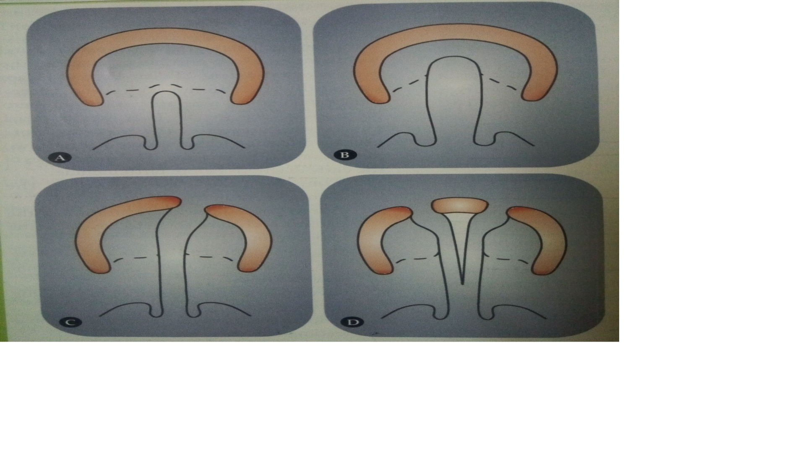
Veau’s classification

Slide 23
SUMMARY
Cleft lip and palate are congenital abnormalities that affect the upper lip and the hard and soft palate of the mouth.
Three main types occur morphologically: 1. Cleft lip (CL) 2. Cleft lip and palate (CLP) 3. Isolated cleft palate (CP).
The patient is afflicted by a number of problems associated with the functions performed by the oral and nasal cavities.
Children born with cleft lip and palate have a number of problems that have to be solved for successful rehabilitation.
The complexity of the problem requires that a number of specialists get together at various stages of development for the eventual betterment of the patient.

Slide 24
REFERENCES
Textbook of Orthodontics – Gurkeerat Singh, Jaypee Brothers; 2nd Edition
Orthodontics – The Art and Science, S.I Bhalajhi, AryaMedi Publishing; 7th Edition
Textbook of Orthodontics – Sridhar Premkumar, Elsevier; 1st Edition
Orthodontics: Diagnosis and Management of Malocclusion and Dentofacial Deformities – O.P Kharbanda, Elsevier; 1st Edition

Slide 25
Question & Answer Session

